Slide 1

Computer Communications
& Networks
CSNC-2413
Week: 5
Computer Networking: A Top Down Approach
6th edition
Jim Kurose, Keith Ross
Addison-Wesley
March 2012
Domain Name System (DNS)
Dr Nauman Mazhar
Faculty of Information Technology (FIT)
University of Central Punjab (UCP)

Slide 2
Chapter 2: outline
2.1 Principles of network applications
2.2 Web and HTTP
2.3 FTP
2.4 Electronic mail
  SMTP, POP3
2.5 DNS
2.6 P2P applications
2.7 Socket programming with UDP and TCP

Slide 3
DNS: domain name system
Hosts/routers attached to Internet identified thru IP addrs
  IP addr: 32 bit long value used in IP pkts
  (hard to remember)
  “name” used by humans
  e.g, www.yahoo.com
Q: how to map between IP address & hostname,
and vice versa ?
  use DNS
Domain Name System:
distributed DB system
  name to IP addr mapping
  DB maintained in hierarchy of many name servers
application-layer protocol:
  allows hosts to query name servers to resolve names
  DNS protocol : UDP port 53
  used by applications,
  e.g, web, file transfer, etc

Slide 4
DNS: resolving hostnames
Example: When browser requests URL, host obtains IP addr of web server using DNS
DNS client runs on host
browser gets hostname from URL, & passes to DNS client
DNS client sends DNS Query to DNS Server
DNS server sends a DNS Reply, containing IP address for the hostname
browser now uses UDP or TCP to talk to HTTP server
On Unix, applications call gethostbyname( )
to invoke DNS

Slide 5
DNS services
DNS services
Address translation: hostname to IP
Host aliasing:
  allows simple alias names for difficult canonical (real) hostnames
  www.ibm.com is an alias for
  servereast.backup2.ibm.com
why not centralize DNS?
traffic volume
single point of failure
distant centralized database
doesn’t scale!
Mail Server aliasing:
  allows to keep email addresses simple
  hotmail.com is an alias for relay1.west-coast.hotmail.com
Load distribution:
  replicated Web servers: many IP addrs correspond to one name

Slide 6
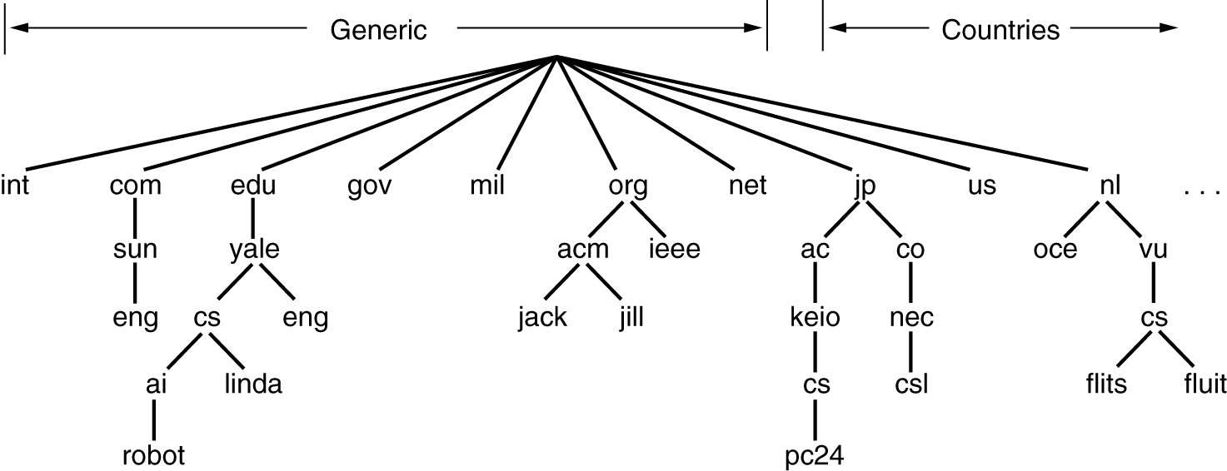
DNS Name Space
DNS servers store hostnames
  hostnames assigned from a Name Space
Internet Domain Name Space divided into domains & sub-domains
  each hostname includes domains, sub-domains
  e.g, robot.ai.cs.yale.edu csl.nec.co.jp
Generic Top Level Domains
Country-Code Top Level Domains

Slide 7
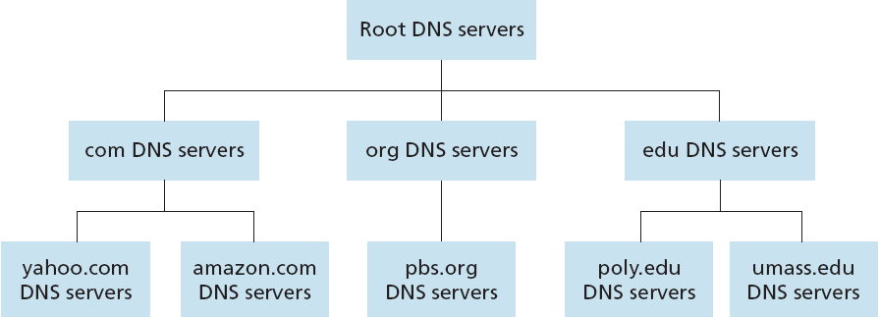
DNS Distributed Database
Large number of DNS servers around the world
Name mapping distributed across DNS servers, hierarchically…
  Root, Top Level Domain (TLD) & Authoritative DNS servers
TLD Name servers
Authoritative Name servers

Slide 8
DNS Distributed Database
Example: IP address needed for www.amazon.com
Root server queried, to find TLD server for com domain
TLD server for com domain queried, to find Authoritative server for amazon.com
Authoritative server for amazon.com queried, to get IP address of host www.amazon.com

Slide 9
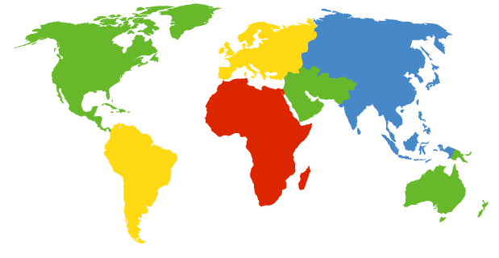
Root name servers
Root name server:
  maintains host name mapping for various TLD Name Servers
    generic TLDs & country-code TLDs
  Root name servers maintained by ICANN
c. Cogent, Herndon, VA (5 other sites)
d. U Maryland College Park, MD
h. ARL Aberdeen, MD
j. Verisign, Dulles VA (69 other sites )
k. RIPE London (17 other sites)
i. Netnod, Stockholm (37 other sites)
e. NASA Mt View, CA
f. Internet Software C.
Palo Alto, CA (and 48 other sites)
m. WIDE Tokyo
(5 other sites)
a. Verisign, Los Angeles CA
(5 other sites)
b. USC-ISI Marina del Rey, CA
l. ICANN Los Angeles, CA
(41 other sites)
13 root name “servers” worldwide
g. US DoD Columbus, OH (5 other sites)

Slide 10
TLD name servers
Top-level domain (TLD) Name Servers:
  maintain host name mappings of Auth Name servers for various types of TLDs
    generic TLDs, country-code TLDs
  various organizations are responsible to maintain TLD Name servers
  Network Solutions : maintains TLD servers for com TLD
  Educause : maintains TLD servers for edu TLD

Slide 11
Authoritative name servers
Authoritative Name Servers:
  organization’s DNS servers
    provide authoritative name mappings for hosts belonging to the organization
  can be maintained by organization, or ISP
  primary & secondary Authoritative Name servers

Slide 12
Local DNS server
Name Server that lies closest to the host
  does not strictly belong to DNS hierarchy
DNS query from host goes to Local DNS server…
  has local cache of recent name-to-address translation pairs
  (but may be out of date..!)
  acts as proxy, forwards query into DNS hierarchy
  provides DNS reply
Each ISP has one (residential ISP, company, university)
  ISP provides host with IP address of local DNS server;
  typically thru DHCP
  also called “default name server”

Slide 13

DNS name
resolution approaches
root DNS server
2
3
host at cis.poly.edu wants IP address for robot.umass.edu
7
6
TLD DNS
server
Recursive Query:
puts burden of name resolution on contacted name server
heavy load at upper levels of hierarchy..?
local DNS server
dns.poly.edu
5
4
1
8
authoritative DNS server
dns.umass.edu
requesting host
cis.poly.edu
robot.umass.edu

Slide 14
DNS name resolution approaches
root DNS server
2
Iterated Query:
contacted server replies with name of server to contact
“ I don’t know this name, but ask this server”
3
4
TLD DNS
server
5
local DNS server
dns.poly.edu
7
6
1
8
authoritative DNS server
dns.umass.edu
requesting host
cis.poly.edu
Are all queries here Iterated..?
robot.umass.edu

Slide 15
DNS: caching, updating records
Once any Name Server learns a mapping, it is cached
  TLD servers are typically cached in Local DNS servers
  thus Root name servers not often visited
  cache entries timeout after some time (often 2 days)
DNS server having cached entry can reply DNS query
  even if not Authoritative for the hostname
Cached entries may be out-of-date...!
  Update/notify mechanisms proposed in IETF standard
  RFC 2136

Slide 16
DNS records
DNS servers store resource records (RR)
Each DNS Reply carries one/more RRs (maps name to value)
RR format: (name, value, type, ttl)
Type=A
  name is hostname
  value is IP address
Type=NS
  name is domain (e.g, foo.com)
  value is hostname of Authoritative name server for this domain
Type=CNAME
  name is alias name for some “canonical” name
  www.ibm.com is really
  servereast.backup2.ibm.com
  value is canonical name
  Type=MX
  value is hostname of mail server associated with domain name

Slide 17
DNS protocol, messages
Query & Reply messages, both have same message format
Msg header
Identification:
  16 bit # for query
  reply to query uses same #
1 bit flags:
  query or reply
  reply is Authoritative
  recursion desired
  recursion available
2 bytes
2 bytes
identification
flags
# questions
# answer RRs
# authority RRs
# additional RRs
questions (variable # of questions)
answers (variable # of RRs)
authority (variable # of RRs)
additional info (variable # of RRs)

Slide 18
DNS protocol, messages
2 bytes
2 bytes
Data Sections
identification
flags
# questions
# answer RRs
# authority RRs
# additional RRs
name, type fields
for a query
questions (variable # of questions)
RRs in response
to query
answers (variable # of RRs)
records for
authoritative servers
authority (variable # of RRs)
additional “helpful”
info that may be used
additional info (variable # of RRs)

Slide 19
Inserting records into DNS
Example: new startup “Network Utopia”
Register domain name networkutopia.com at DNS Registrar
(e.g, Network Solutions)
  provide names, IP addresses of Authoritative name servers
  (primary & secondary)
  Registrar inserts two RRs into com TLD server:
  (networkutopia.com, dns1.networkutopia.com, NS)
  (dns1.networkutopia.com, 212.212.212.1, A)
Create following RRs in your Authoritative DNS servers
  type A for web server, www.networkutopia.com
  type MX for mail server, mail.networkutopia.com
  type A for mail server, mail.networkutopia.com

Slide 20
Class Activity 1
Info regarding DNS records for a corporation, Lottery:
Name | Type | Value
lottery.co.uk | NS | grove.lottery.co.uk
lottery.co.uk | NS | tree.lottery.co.uk
lottery.co.uk | MX | stem.lottery.co.uk
grove.lottery.co.uk | A | 91.45.23.22
tree.lottery.co.uk | A | 91.45.23.23
orchard.lottery.co.uk | A | 91.45.23.82
stem.lottery.co.uk | A | 91.45.23.85
www.lottery.co.uk | CNAME | orchard.lottery.co.uk
Write IP addrs of Authoritative DNS servers for the domain lottery.co.uk
What is the IP addr of their web server
What is the IP addr of their mail server

Slide 21
Class Activity 2
Suppose a client wants to open www.cs.mit.edu on his web browser for the first time
For given figure, draw the path showing the sequence of DNS Queries & Replies, for both Recursive & Iterative queries; also explain if the query will be Iterative or Recursive
ROOT
DNS
EDU
DNS
COM
DNS
Client
Local DNS Server
tilda
DNS
mit
DNS
cs.mit
DNS

Slide 22
Consider the following RRs…
  mention the RR that will be suitable in each DNS reply given by server (can be more than one)
 | NAME | VALUE | TYPE
1 | mit.edu | 128.112.155.166 | A
2 | DNS.cs.mit.edu | 128.112.136.10 | A
3 | DNS.edu | 192.5.6.32 | A
4 | DNS.mit.edu | 128.112.129.15 | A
5 | mail.mit.edu | 128.112.129.30 | A
6 | cs.mit.edu | DNS.cs.mit.edu | NS
7 | edu | DNS.edu | NS
8 | tilda.edu | DNS.tilda.edu | NS
9 | tilda.edu | mail.tilda.edu | MX
10 | com | DNS.com | NS
11 | DNS.com | 160.102.12.3 | A
12 | mit.edu | DNS.mit.edu | NS
13 | www.cs.mit.edu | 128.112.155.177 | A

